Slide 1
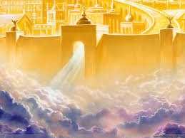
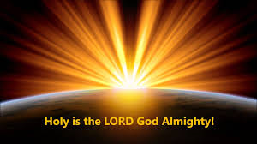
親眼看見你
My eyes have seen thee

Slide 2
有祢我生命不一樣
有祢我生命再燃亮
有祢我不害怕困難
有祢我有滿足的喜樂
Your presence makes my life different Your presence makes my life bright In your presence there is no fear In your presence there is fullness of joy
My eyes have seen thee 1/3

Slide 3
我在深處裡求告祢
祢在天上聽我禱告
你是我堅固避難所
我讚美祢直到永遠
Out of the depths I cry to you, O Lord You listen to me in heaven when I pray You are my strong refuge I praise You forever
My eyes have seen thee 2/3

Slide 4
太陽還存月亮還在
人要敬畏祢直到萬代
我從前風聞有祢
現在我親眼看見祢
May they fear you while the sun endures and as long as the moon, throughout all generations!
I had heard of you by the hearing of the ear
but now my eye sees you
My eyes have seen thee 3/3

